Slide 1

Fundamental Concepts in Machine Learning (2)
Professor Bo Liu
James Watt School of Engineering

Slide 2
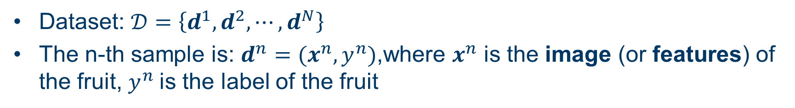
Fundamental concepts in supervised learning
Supervised learning is when the model is getting trained on a labelled dataset.
Labelled dataset is one which have both input and output parameters.
Fruit classification example:
Dataset: $𝒟=\left\{d^{1},d^{2}, ⋯,d^{N}\right\}$
The n-th sample is: $d^{n}=(x^{n},y^{n})$,where $x^{n}$ is the image (or features) of the fruit, $y^{n}$is the label of the fruit

Slide 3
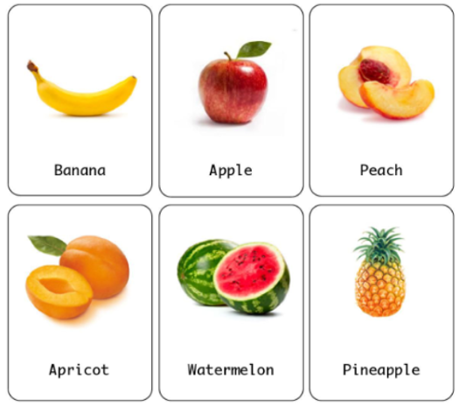
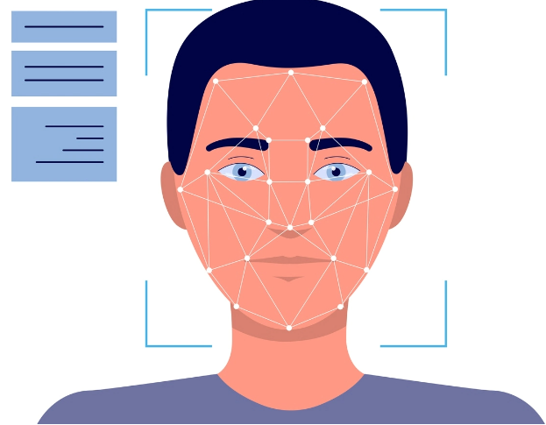
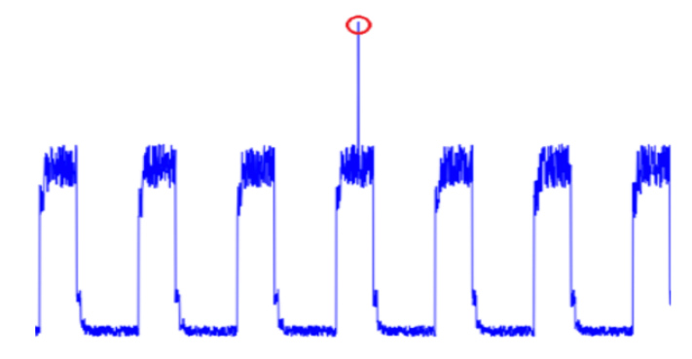
Supervised Learning: classification
  Classification: a supervised learning task in which the output is discrete.
Classification examples:
fruit classification
facial recognition
anomaly network flow detection
fruit classification
facial recognition
Anomaly detection in IoT network

Slide 4
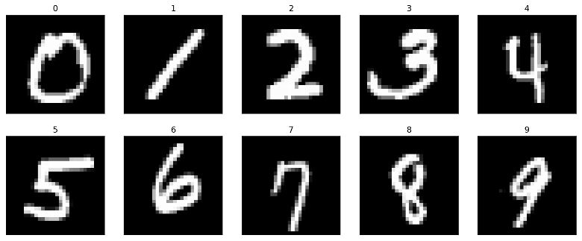

Classification
Classification Example : Handwritten digits recognition
Handwritten digit recognition has many applications in various fields like zip code recognition.
0 1 2 3 4 5 6 7 8 9
Input
ML model
Output

Slide 5
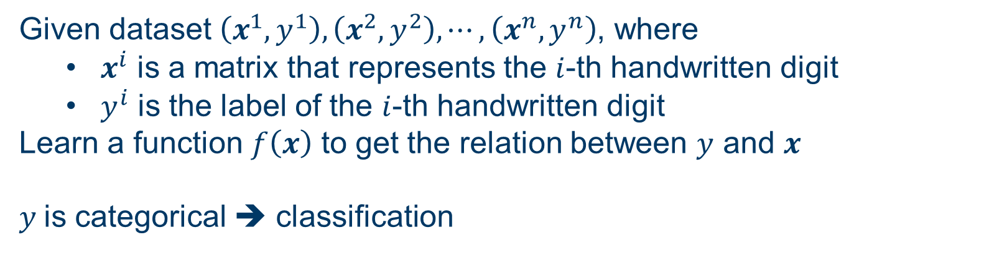


Classification
Classification Example : Handwritten digits recognition
Given dataset $\left(x^{1},y^{1}\right), \left(x^{2},y^{2}\right), ⋯,\left(x^{n},y^{n}\right)$, where
  $x^{i}$ is a matrix that represents the $i$-th handwritten digit
  $y^{i}$ is the label of the $i$-th handwritten digit
Learn a function $f\left(x\right)$ to get the relation between $y$ and $x$
$y$is categorical ➔ classification
Input
ML model
Output
$$x$$
Prediction on $y$

Slide 6
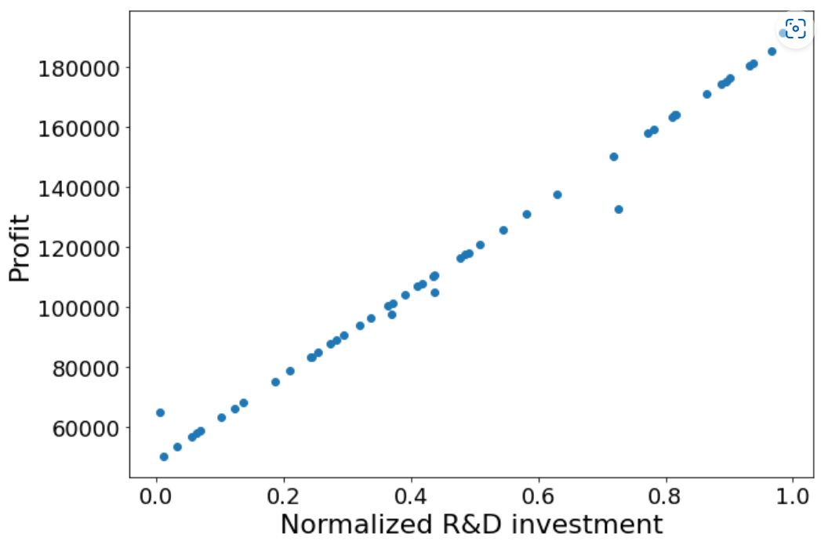
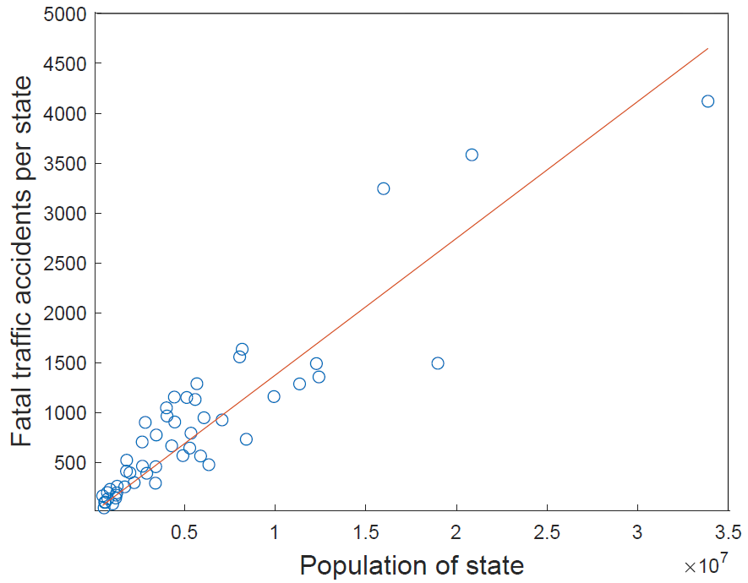
Supervised Learning: regression
  Regression: a supervised learning task in which the output is continuous.
regression examples: financial prediction, traffic accident prediction, etc.
financial prediction
traffic accident prediction

Slide 7
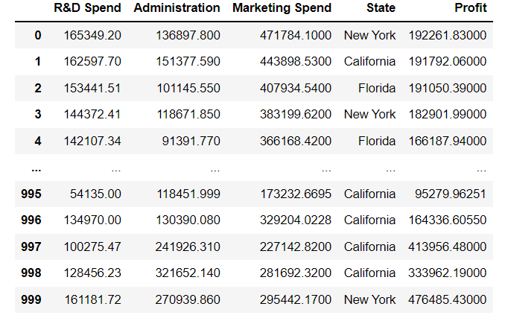
Regression
Financial prediction problem description
Given R&D spend, administration spend, the marketing spend, and the location (state) of a company
How much profit can the company expect to make?

Slide 8
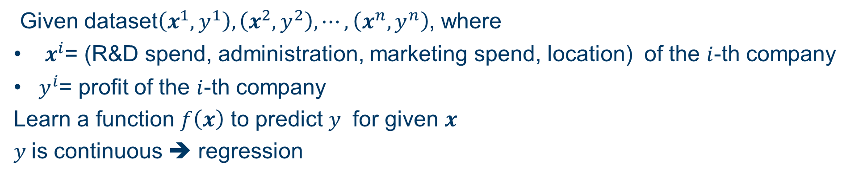
Regression
Regression Example: Financial prediction
Given dataset$\left(x^{1},y^{1}\right), \left(x^{2},y^{2}\right), ⋯,\left(x^{n},y^{n}\right)$, where
  $x^{i}$= (R&D spend, administration, marketing spend, location) of the $i$-th company
  $y^{i}$= profit of the $i$-th company
Learn a function $f\left(x\right)$ to predict $y$ for given $x$
$y$is continuous ➔ regression

Slide 9
Semi-supervised Learning
In Semi-Supervised Learning, the model is trained by the dataset with
  A few labeled data
  A lot of unlabeled data
1. train
Model
labeled data
unlabeled data
2. predict
predicted pseudo-labeled data
labeled data
3. retrain
Model

Slide 10
Unsupervised Learning
The input to the unsupervised learning model are all unlabeled data
Unsupervised learning is to model the underlying structure/distribution of the data without explicit instructions

Slide 11
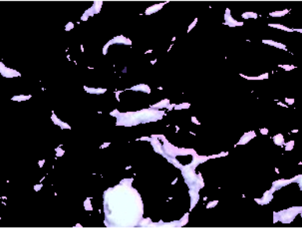
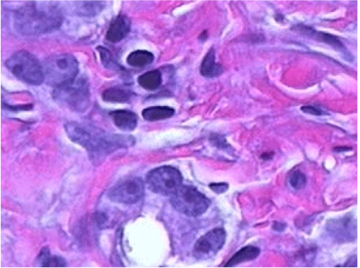
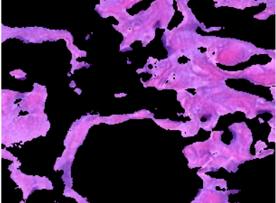
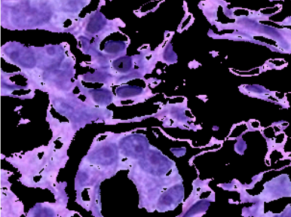
Unsupervised Learning
Example of Unsupervised Learning: Color-based image segmentation
Segment 1
Unlabeled data
Segment 2
Unsupervised Learning
Segment 3

Slide 12
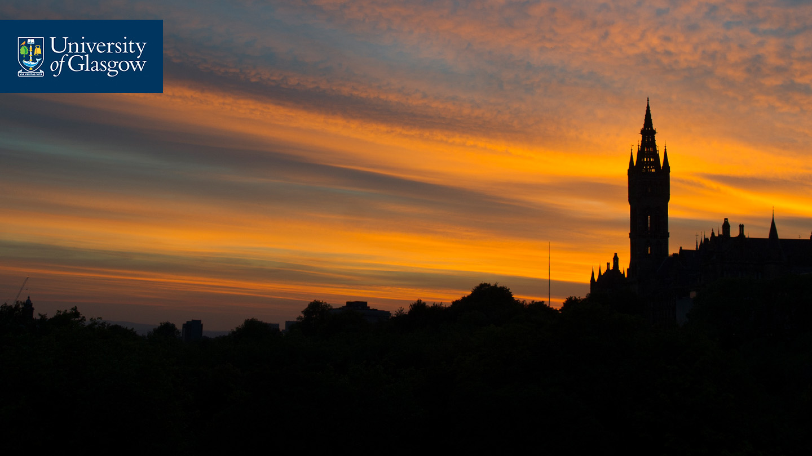



Thanks!
#UofGWorldChangers
@UofGlasgow

